Slide 1
Python for
Absolute Beginners
Al Sweigart
PyCon US 2026 Tutorial
https://inventwithpython.com/pyconus2026
Notes:
Hello, thank you for coming to PyCon US and for coming to my tutorial, Python for Absolute Beginners. You should each have a workbook, and a red and green post-it note. You’ll be writing in the notebook so I have pens and pencils. All of the workbook materials and these slides are on my website, inventwithpython.com/pyconus2026 This tutorial is 3 and a half hours, but we’ll have a couple 10-minute breaks.

Slide 2
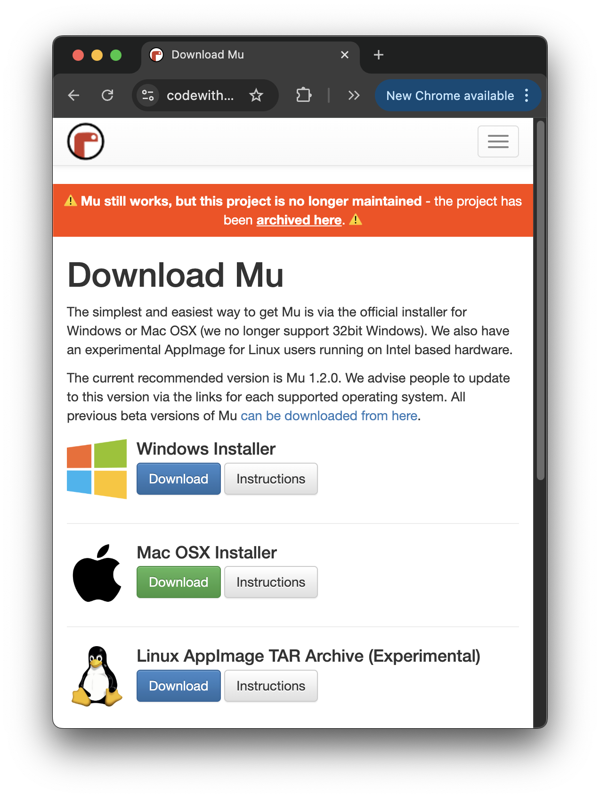
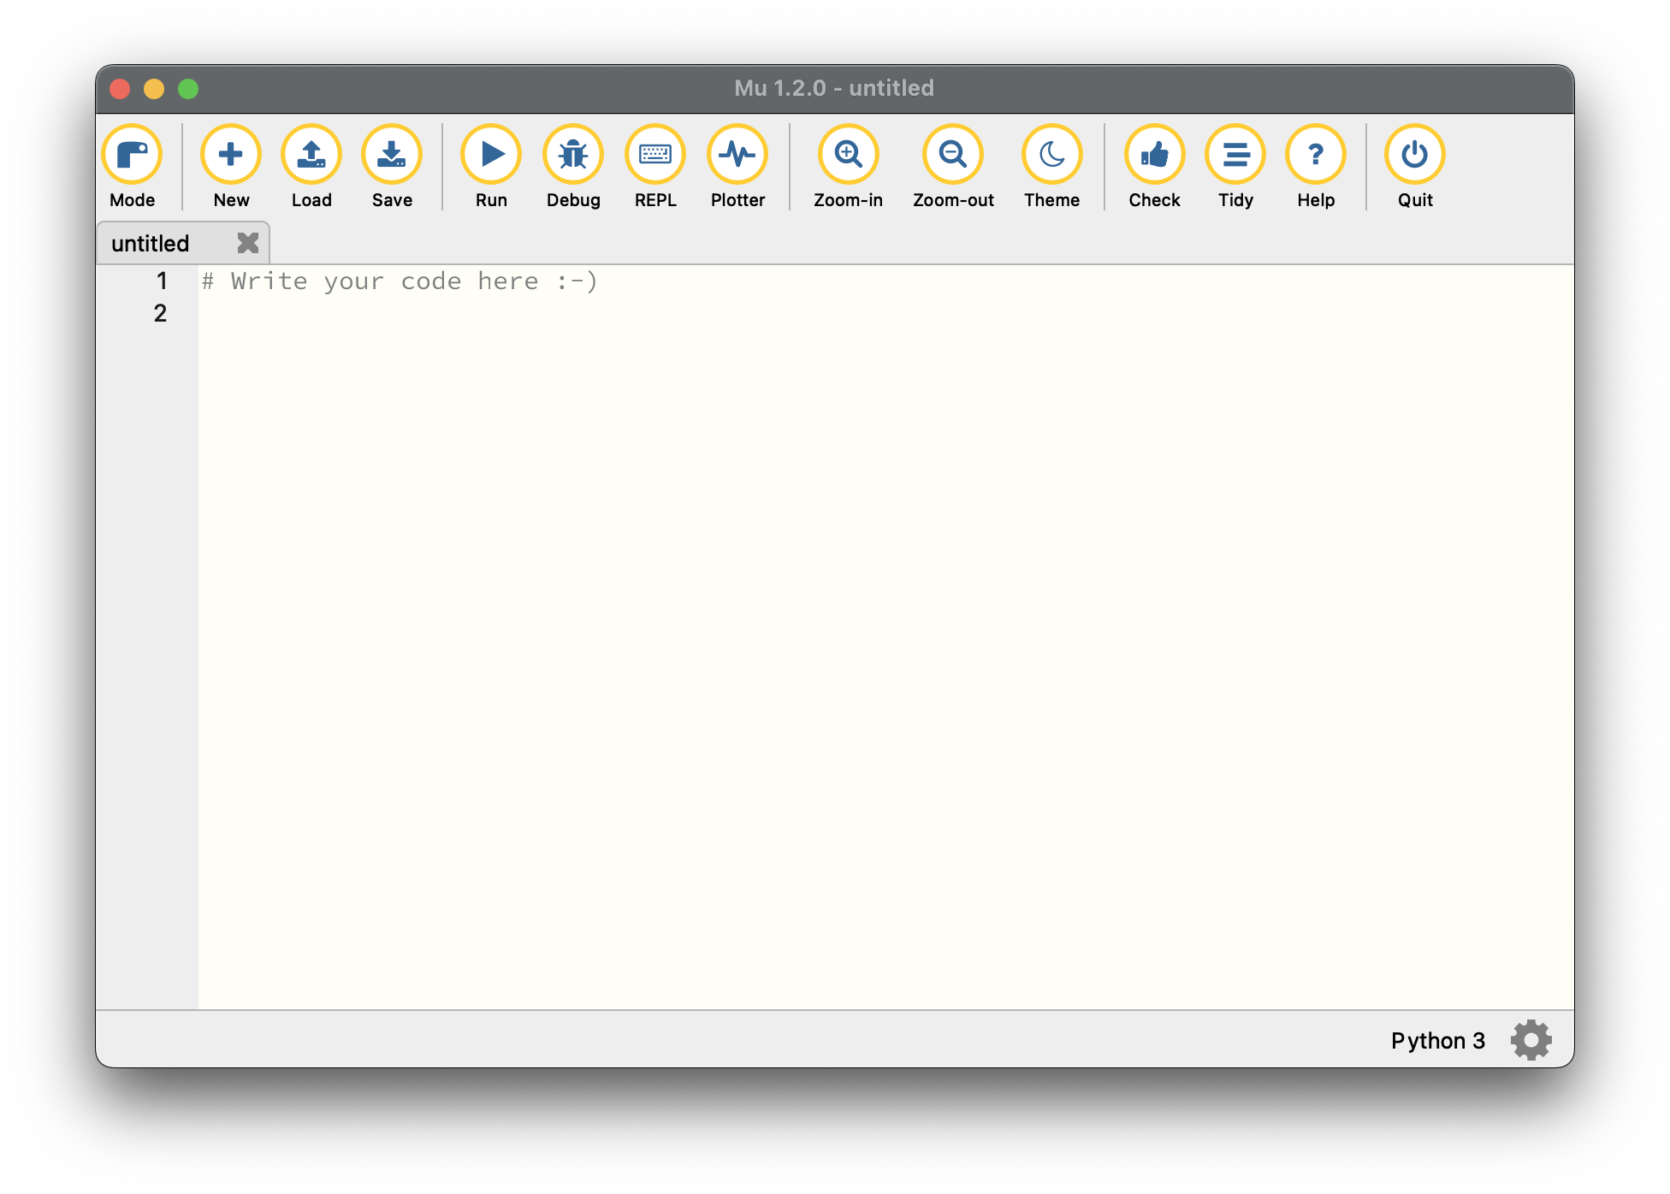
Last Second Installing of Mu If You Haven’t Done That Yet
https://codewith.mu/
Notes:
I sent out emails to install the Mu code editor on your laptop. If you haven’t done that, you can do it now by downloading it from codewith.mu. I picked this one because it’s the simplest code editor, but if you’re already familiar with IDLE or Visual Studio Code, you can use those too. You can install Mu while I’ll give this introductory talk before we begin.

Slide 3
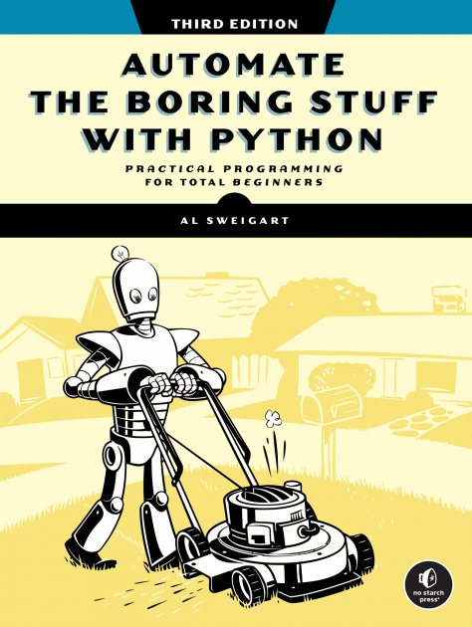
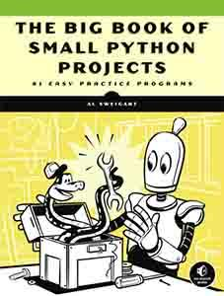
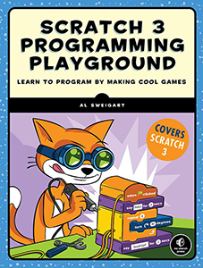
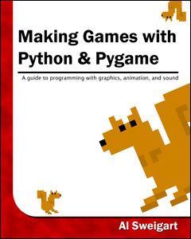
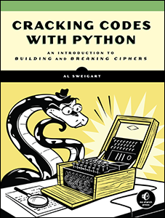
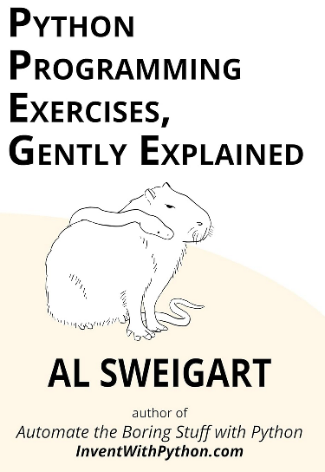
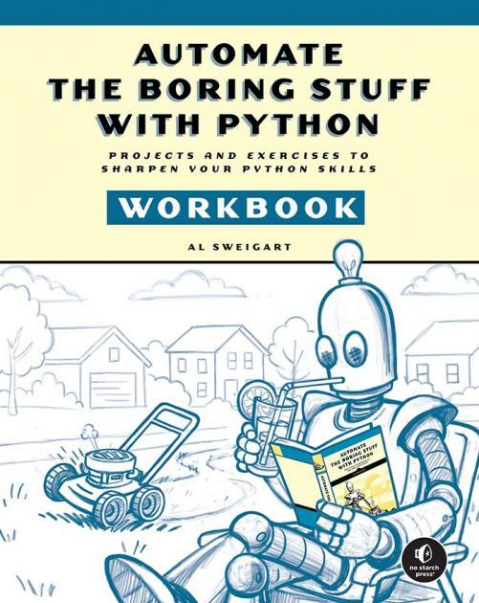
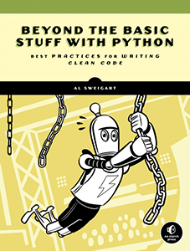
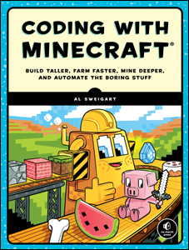
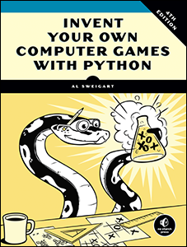
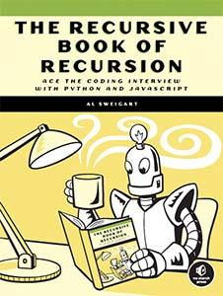
Who Am I?
Al Sweigart (last name rhymes with “why dirt”)
I wrote Automate the Boring Stuff with Python
I wrote a bunch of other programming books
All the books are free at https://inventwithpython.com
Notes:
Hi. I’m Al Sweigart. I’ve been writing programming books for the last 17 years now. I’m mostly known for Automate the Boring Stuff with Python. All of them are for free under a Creative Commons license at inventwithpython.com

Slide 4
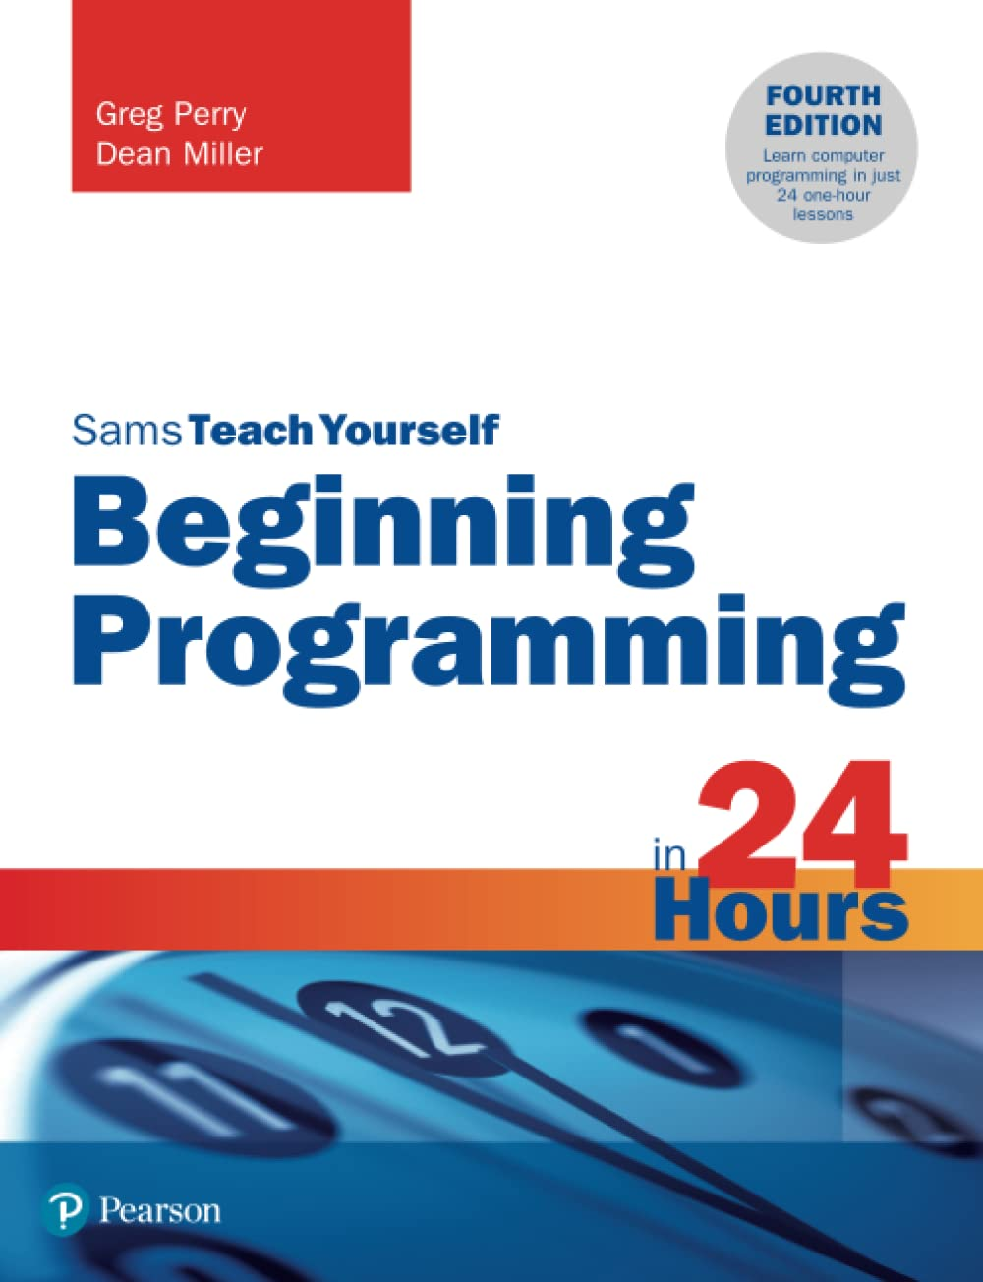
BAD NEWS:
You cannot learn to program in 3 ½ hours.
GOOD NEWS:
You can get a good start in 3 ½ hours.
Notes:
When I was learning to program, there were a bunch of books with titles like “learn to code in 7 days” or “learn programming in 24 hours” and the thing is, you can’t learn to program in that short amount of time. Think of coding as like learning a musical instrument; what you can learn in 3 and a half hours are enough basics so that you can continue on your own. I used to teach a saturday morning kids programming class where we’d make little video game projects. I’d ask them what game they’d want to make and the kids would go, “Minecraft!” Yeah, the class was only an hour long and we have a budget of zero dollars. Mostly I wanted them to come away from the class thinking that programming was cool and something they are capable of doing. At the end of this tutorial, I want you to have the basic familiarity needed so that you can continue to learn on your own. Just have a basic feel for what programming is.

Slide 5
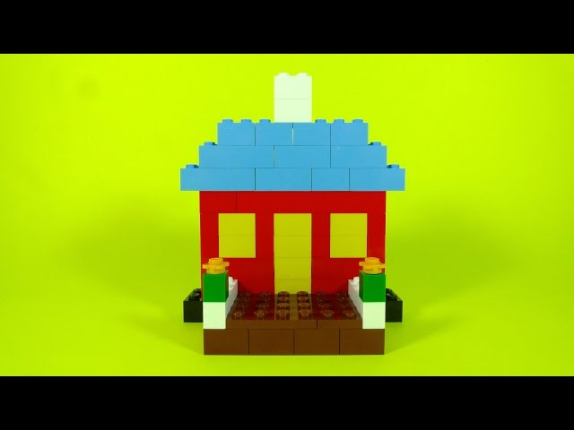
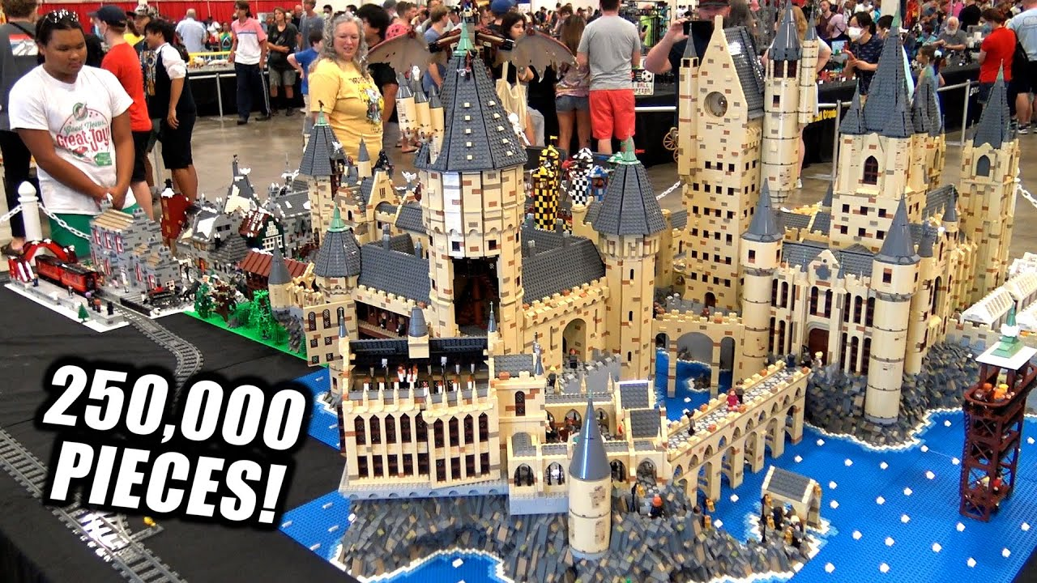
https://scrollart.org
We are doing this.
Not this.
Notes:
When you think of software, you’re probably thinking of iphone apps or Excel or social media websites. We’re going to be making programs that display text on the screen and accept text from the keyboard. There’s no windows, no buttons or menus. They don’t even use the mouse. These program look really boring, but on the upside they are very simple. But simple can still be fun. I have a whole set of programs that just print out text and fill the screen, causing it to scroll upwards. I call it scroll art.

Slide 6
My Pet Peeve
“What you should really teach is critical thinking.”
Notes:
Right. So a lot of people think they need to be good at math to program. The short answer is: no, you don’t. The computer does the math for you. And then some software engineers say that it’s not math or even programming that people need, but “critical thinking”. This annoys me, because it’s really vague. What does “learning critical thinking” actually look like? If you do an amazon search for it, you get a lot “brain building puzzle” kind of books, mostly AI generated slop. Programming forces you to think in a way that we aren’t used to in regular life. You have make deductions, observe details, deal with symbolic reasoning; this is great practice for critical thinking. Even if you don’t become a software engineer, I think it’s useful to have this experience.

Slide 7
What Is Python? (language)
Python is a programming language - “I wrote a program in Python.”
Python is free, open source, and community-maintained
Python became really popular in the 2010s
Python is surprisingly old: the first release was made in 1991
Python is the best first programming language to learn
Notes:
Okay. I’m going to skip a lot of the text on these slides. What is Python. Python is a few different things. Python is a programming language; it’s a set of grammar and syntax rules for writing computer instructions. You’d say, “I wrote a program in Python”. If you ask what the best programming language is, the answer is, “Well it depends.” But if you ask what the best first programming language for beginners to learn, the answer is absolutely “Python”. I will argue for this until I’m blue in the face. Software nerds might disagree with me but they are wrong. You did a great job choosing to learn to code with Python. Python as a language is simple while also still a serious language used by the tech industry.

Slide 8
What Is Python? (software)
Python is the free interpreter software that runs Python code - “Python ran this program” “Python gave me an error message”
You download the Python interpreter from https://python.org
(The Mu code editor bundles Python with it.)
Notes:
Python is also software. It’s the interpreter software that you download from python.org (or in our case, the interpreter is bundled with the Mu code editor) and it carries out the instructions written in the Python language. You’d say, “Python ran this program” or “Python gave me an error message”

Slide 9
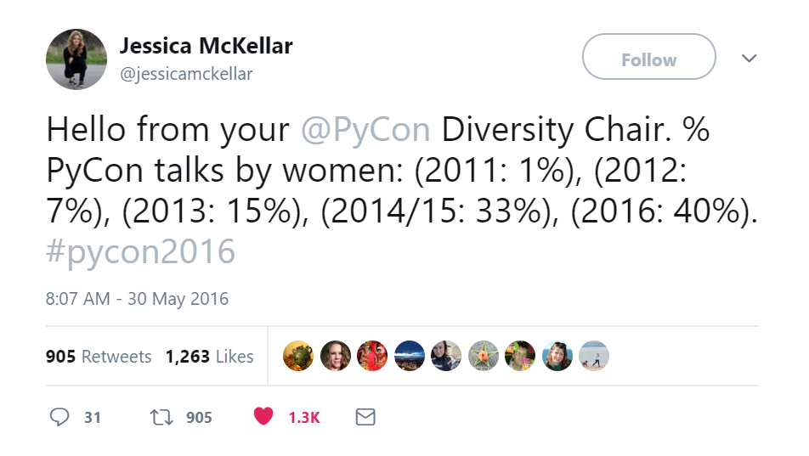
What is Python? (community and ecosystem)
“The hardest part of tech is never the tech.”
“Come for the language, stay for the community”
Notes:
But Python is also a community of people and an ecosystem of tools and software libraries. You could make your own programming language, but so what? Who would use it? Python has a great community, PyCon is by far the friendliest tech conference I’ve been to. And there’s a huge amount of software libraries and tools you can use, almost all of which is free.

Slide 10
You Will Not Break or Damage The Computer
Nothing in this tutorial will damage your computer
Error messages just mean the Python interpreter didn’t understand your code, so it stopped
“Crashing” just means the Python interpreter didn’t understand your code, so it stopped running the program
Error message worksheet: Gotta Catch ‘Em All!
DON’T PANIC!
Notes:
The main problem people have when learning to program isn’t that they aren’t smart enough or good at math enough, but they have this intimidation factor that’s hard to get over. Let me say this: nothing in this tutorial will break or damage your computer. I know we say, “the program crashed” but that’s not hurting anything. Crashing is really just that the Python interpreter couldn’t understand an instruction you gave it, so it just stopped running the program. Error messages look a bit cryptic and scary, so let’s make a game of it. On the last page of the workbook there is a Gotta Catch Em All worksheet for error messages. Every time you encounter an error in this tutorial, flip back and write down the error message itself and the line of code that caused it. Try to collect as many different kinds of errors as you can. I’ll walk with you through it for the first few errors.

Slide 11
Programming is Something You Do
Re-typing the source code forces you to slow down and get “muscle memory”
Slow is smooth and smooth is fast
Watching videos or reading blog posts is forgettable
Copy/pasting code keeps you from paying attention to it
Having AI generate code keeps you from paying attention to it
Googling and looking things up is not “cheating”
Notes:
Programming is something you do. If you just read about it, you’ll forget it. The style of this tutorial is typing in the code for the example programs yourself. I purposefully don’t go into every detail of every concept we cover, because we have 3 and a half hours. I also have parts of this tutorial where you write things down in the workbook because if you only type things into your computer, it’s really easy to forget about after a few days. Please do actually write things down in the workbook. It is yours to keep. In fact, right now, go ahead and write your name on the first page. I want you to get used to treating this workbook as something to be used and not kept in a pristine state. All of this writing and typing may feel like it slows you down but it also helps you pay attention and remember what you’re doing here. I like to say slow is smooth and smooth is fast.

Slide 12
Al’s Thoughts On Using AI To Learn To Code
Don’t.
Notes:
Speaking of which, the elephant in the room is AI. Bringing a forklift to the gym can lift heavy things, but it doesn’t make you stronger. Ordering off of a menu gets you a delicious meal, but it doesn’t teach you to cook. You are not missing out by learning to code without AI.

Slide 13
Software that
works
Software that looks like it works
Notes:
Going into the details of why this is the case would take 3 hours, so instead I’ll summarize it with this venn diagram: there’s software that works, and there’s software that looks like it works. And the latter is far bigger than the former. If you don’t know how code works, then this…

Slide 14
Software that
works
Software that looks like it works
Notes:
…looks like this. Long story short, there is value in learning to code, and understanding why code works.

Slide 15
LET’S BEGIN
Notes:
Alright. Let’s begin.

Slide 16
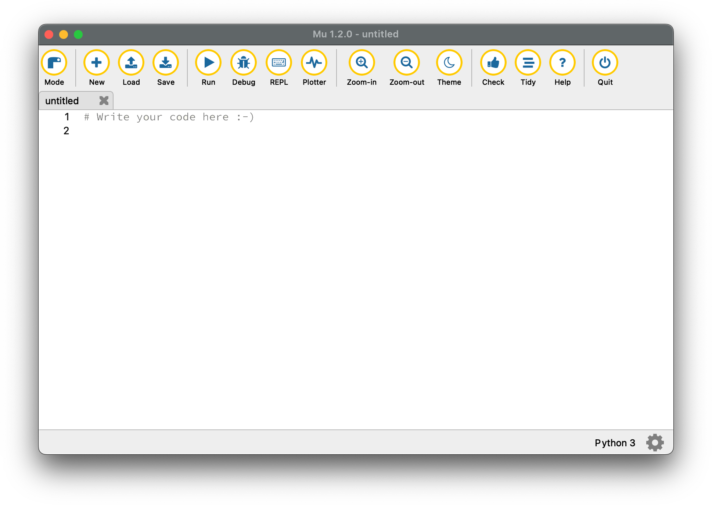
Mu, the Code Editor App
WORKBOOK p2: “Mu, the Code Editor App”
GREEN FLAG: When you’ve read page 2 & 3 and have Mu opened
If you can’t open it, DON’T PANIC. Open https://pythontutor.com
Notes:
Open your workbook to page 2 and read pages 2 and 3 and open the Mu code editor. For these workbook activities, we’re going to use the green and red post its. When you’ve finished reading those two pages and have Mu open on your computer, put the green post it note at the top of your laptop behind the screen. That way we can we see when everyone is done. If you have a question, put the red post it note on your laptop, but also raise or hand or try to get our attention if we don’t see it.

Slide 17
Hello, world!
WORKBOOK p4: “Example Program: Hello, World!”
GREEN FLAG: When you’ve run hello.py by clicking the Run button.
If you get an error message, double check for typos.
Get our attention or put up the RED FLAG if you have a question.
If Mu isn’t working, DON’T PANIC. Enter the program into https://pythontutor.com

Slide 18
Hello, world!
WORKBOOK p5: Run the “Hello, World!” Program Again With Silly Input
GREEN FLAG: When you’ve run the program with silly input

Slide 19
Comments
Comments are text in the source code that the Python interpreter ignores
Programmers use comments to make notes or explain the code
Comments begin with # and go to the end of the line
It’s good style to put one space between the # and the comment text.
#Don’t do this.
>>> # This si a comment.

Slide 20
print() TODO

Slide 21
Function Calls and Arguments
Functions are like mini-programs in your program
We type their names with parentheses to mark them as functions: print()
You can run the code in them by calling them
Function calls can accept zero or more input data called arguments
TODO two args, user_name doesn’t have quotes

Slide 22
Rules for Variable Names TODO cut
Case-sensitive: SPAM, spam, Spam are separate variables
Can only have letters, numbers, and _ underscores
Cannot begin with a number
Must be one word; cannot have spaces (use an underscore instead)
Cannot be a Python keyword (if, else, while, for, return, True, False; we’ll see these later)
Good Advice: Make the variable name describe the data the variable contains. Labelling your moving boxes as “stuff” isn’t helpful.

Slide 23
Hello, world!
WORKBOOK p6: Flow Chart for the “Hello, World!” Example Program
WORKBOOK p7: Run the “Hello, World!” Program Under the Debugger
GREEN FLAG: When you’re done running the program under the debugger

Slide 24
REPL - Calculator Stuff
WORKBOOK p9: “Calculator Stuff” in the REPL / Interactive Shell
GREENFLAG: When you’ve filled out the page

Slide 25
Expressions, Values, and Operators
Values are pieces of data, such as numbers or text
Operators like + - * / act on data
Expressions are instructions made up of values and operators that evaluate to a single value
Expressions can look like math problems like 2 + 2, but there are non-math expressions too
Evaluation animation: https://inventwithpython.com/pyconus2026/evalexpr.html

Slide 26
Strings and String Operations
Strings are values that represent text
String values begin and end with a single quote (you can also use double)
The + operator can concatenate two string values together
The * operator can replicate a string and an int value

Slide 27
REPL - Strings
WORKBOOK p10: String Concatenation and String Replication in the REPL / Interactive Shell
GREEN FLAG: When you’ve filled out the page

Slide 28
Boolean Values and Comparison Operators
The Boolean data type has exactly two values: True and False
There are six comparison operators: == != < <= > >=
Expressions with comparison operators evaluate to Boolean values:
42 < 10 evaluates to False

Slide 29
REPL - Boolean Values
WORKBOOK p11: Boolean Values and the Comparison Operators in the REPL / Interactive Shell
GREEN FLAG: When you’ve filled out the page

Slide 30
Temperature Conversion
WORKBOOK p12: Writing a Math Equation as Python Code
GREEN FLAG: When you’ve filled in the blanks and entered the code into the REPL.

Slide 31
Temperature Conversion
WORKBOOK p13: Example Program: Fahrenheit / Celsius Temperature Conversion
GREEN FLAG: When you’ve run the program a couple times with different temperatures to convert

Slide 32
if Statements
Sometimes you want code to only run if a certain condition is true, that is, if an expression evaluates to True. For these cases, you want an if statement which is made up of:
The if keyword (must be lowercase)
A condition (an expression that evaluates to True or False)
A colon
An indented block of code starting on the next line. The “block” is made of the lines of code with the same level of indentation. The block ends when the indentation ends.
if name == 'Albert':
print('Hello')

Slide 33
Temperature Conversion
WORKBOOK p14: Flow Chart for the Temperature Conversion Program
WORKBOOK p15: Run the “Temperature Conversion” Program Under the Debugger
GREEN FLAG: When you’ve run the program under the debugger a couple times.

Slide 34
The round() Function
WORKBOOK p16: The round() Function
WORKBOOK p17: Add the round() Function to the Temperature Conversion Program
GREEN FLAG: When you’ve added the round() function to the program and re-run it.

Slide 35
Importing Modules
Python comes with several functions to do useful and common actions. It would slow your program down if Python loaded ALL of them for EVERY program, so some functions exist inside of modules that you can import into your program with import statements.
import random

Slide 36
Importing Modules
WORKBOOK p18: Importing Modules and the random.randint() and sys.exit() Functions
GREEN FLAG: When you’ve filled in the blanks on the page.

Slide 37
The % Modulo Operator
WORKBOOK p19: Calculating If a Number is Even or Odd
GREEN FLAG: When you have filled in the blanks on the page.

Slide 38
Boolean Operators and Truth Tables
WORKBOOK p20: Boolean Operators and Truth Tables
GREEN FLAG: When you’ve filled in the blanks on the page

Slide 39
else Statements
An else statement can optionally follow an if statement. Think of it as “If this condition is true, run this block, or else if the condition was false, run this other block.
if some_variable == 5:
# block of code
else:
# other block of code
One and only one of the code blocks is run.

Slide 40
Cho Han Dice Game
WORKBOOK p21: Example Program: Cho Han Dice Game
GREEN FLAG: When you’ve run the program a few times

Slide 41
Cho Han Dice Game
WORKBOOK p22: Flow Chart for the Cho Han Dice Game Program
WORKBOOK p23: Run the “Cho Han Dice” Program Under the Debugger
GREEN FLAG: When you’ve run the program under the debugger

Slide 42
while Loops
while Loops look very similar to if statements, except they have the while keyword instead of the if keyword, and the execution loops back to the start of the while statement when it reaches the end.
A while statement says, “While this condition is True, run the code in this block”

Slide 43
“Your Name” Program
WORKBOOK p24: while Loops and the Example Program: “Your Name” Joke
GREEN FLAG: When you’ve run the program

Slide 44
“Your Name” Program
WORKBOOK p25: Flow Chart for the “Your Name” Program
WORKBOOK p26: Run the “Your Name” Program Under the Debugger
GREEN FLAG: When you’ve run the program under the debugger

Slide 45
Infinite Loops and break statements
If you use while True: then the condition of the while statement is ALWAYS true and you have an infinite loop.
A break statement causes the execution to leave (“break out of”) the while loop.

Slide 46
“Your Name” 2 Program
WORKBOOK p27: Infinite Loops, break Statements, and the “Your Name 2” Program
GREEN FLAG: When you’ve run the program

Slide 47
“Your Name” 2 Program
WORKBOOK p28: Flow Chart for the “Your Name 2” Program (with a break Statement)
WORKBOOK p29: Run the “Your Name 2” Program Under the Debugger
GREEN FLAG: When you’ve run the program under the debugger

Slide 48
for Loops
A while loop says “run this block of code while this condition is true”
A for loop says “run this block of code a specific number of times”
for i in range(10): runs the code block ten times
The i variable starts with value 0, then 1, then 2, up to (but not including) 10

Slide 49
Clever Carl
WORKBOOK p30: Example Program: Clever Carl
WORKBOOK p31: An Equivalent Clever Carl Program Without the for Loop
GREEN FLAG: When you’ve run the program and read through page 31

Slide 50
Clever Carl
WORKBOOK p32: Flow Chart for the “Clever Carl” Program
WORKBOOK p33: Break Points and Running the “Clever Carl” Program Under the Debugger
GREEN FLAG: When you’ve run the program under the debugger with break points

Slide 51
end= in print()
By default, a newline character (typed in code as '\n') is printed at the end of the string you pass to print()
We can change this to a space so that the text fills up horizontally instead of vertically: print('Hello', end=' ') and print('world!') prints Hello world! on the same line.
end=' ' is called a keyword argument

Slide 52
The range() Function
The range() function can be called with one, two, or three arguments.
range(stop) starts i at 0 and goes up to but not including stop
range(start, stop) starts i at start and goes up to but not including stop
range(start, stop, step) starts i at start and goes up to but not including stop, increasing i by step instead of by 1
range(10) is the same as range(0, 10) or range(0, 10, 1)

Slide 53
The range() Function
WORKBOOK p34: The range() Function
GREEN FLAG: When you’ve filled in the blanks

Slide 54
Guess the Number
WORKBOOK p35: Example Program: Guess the Number
GREEN FLAG: When you’ve run the program

Slide 55
Guess the Number
WORKBOOK p36: Flow Chart for the “Guess the Number” Program
WORKBOOK p37: Run the “Guess the Number” Program Under the Debugger
GREEN FLAG: When you’ve run the program under the debugger

Slide 56
Nested Loops
You can put loops inside of other loops!
Think of it as the seconds hand of a clock must go in a full circle to move the minutes hand over by 1, and the minutes hand must go in a full circle to move the hour hand by 1.
https://inventwithpython.com/nested-loops.html

Slide 57
Clock Hands 1
WORKBOOK p38: Example Program: Clock Hands 1
GREEN FLAG: When you’ve run the program

Slide 58
Clock Hands 1
WORKBOOK p39: Flow Chart for the “Clock Hands 1” Program
WORKBOOK p40: Break Points and Running the “Clock Hands 1” Program Under the Debugger
GREEN FLAG: When you’ve run the program under the debugger

Slide 59
Clock Hands 2
WORKBOOK p41: Example Program: Clock Hands 2
GREEN FLAG: When you’ve run the program

Slide 60
Clock Hands 2
WORKBOOK p42: Flow Chart for the “Clock Hands 2” Program
WORKBOOK p43: Break Points and Running the “Clock Hands 2” Program Under the Debugger
GREEN FLAG: When you’ve run the program under the debugger

Slide 61
Defining Your Own Functions
You can define your own functions with a def statement:
def function_name():
# some code goes here
function_name() # calls the function
This prevents you from copy/pasting the same code. Define the function once and call it multiple times.
If you need to change the code, there’s only one place that needs to be changed.

Slide 62
Starfield Scroll Art
Scroll art programs produce interesting animations using print() inside of infinite loops. Other scroll art examples: https://scrollart.org
WORKBOOK p44: Example Program: Starfield Scroll Art
GREEN FLAG: When you’ve run the program

